Slide 1




¹ VRAIN, Universitat Politècnica de València ² Leverhulme Centre for the Future of Intelligence, University of Cambridge ³ Centre for the Study of Existential Risk, University of Cambridge http://josephorallo.webs.upv.es/
Item Response Theory for NLP:
Lesson 4. Advanced Topics
José Hernández-Orallo^{1,2,3}
EACL Tutorial, March 2024
John P. Lalor, Pedro Rodriguez, João Sedoc, Jose Hernandez-Orallo,
Notes:
Item Response Theory for NLP: From IRT to Measurement Layouts
With the advent of general-purpose systems in AI, such as large language models, their evaluation is finally transitioning from the reporting of aggregate performance on some benchmarks to the extraction of capabilities in more well-thought measurement experiments, in a way that should resemble the theory and practice of psychological measurement. I will illustrate some examples where Factor Analysis and Item Response Theory have been applied to AI evaluation in the past. In these psychometric approaches, estimating capabilities excels over measuring performance in that capabilities aim to be independent from the task distribution. However, the parameters and factors in these models are still highly dependent on the underlying population of AI systems, which are more arbitrary and changing than human or animal populations. To address this issue, we need a more cognitive, intrinsic approach, identifying task demands and mapping the capabilities that can meet these demands. Under this perspective, I will present a new approach referred to as 'measurement layouts', generalised (non-linear) Hierarchical Bayesian Networks that can infer the latent capabilities of a single AI system from observed performance and task demands, and then predict performance for new tasks. Measurement layouts provide understanding of what makes an individual AI system fail and anticipation of performance for future tasks. At the end of the talk, I'll invite attendees to an open discussion on how measurement layouts compare to other novel approaches such as Assessors (performance models trained on test data) and more traditional approaches such as Structural Equation Modelling (if used for individuals).

Slide 2
Main Limitations of (classical) IRT

Slide 3
Limitations of classical irt...
1) Only considers one ability per subject (and one difficulty parameter per item)
One ability rarely accounts for the full behaviour of a system on general or complex tasks.
2) The models are usually simple and fixed (logistic).
Some performance metrics have distributions that are not Bernoulli (right/wrong: {0,1} loss), but Beta (Brier/AUC: [0,1] loss), Gamma (MAE/MSE: [0,∞] loss) or some other distribution
3) MIRT models are non-hierarchical (on the items and on the abilities)
Compensatory MIRT models introduce effects between the dimensions
4) Cannot predict for new instances (only those used in the estimation)
They do not have item parameters (we would need the results of other models on that new item).
5) Is populational
In many cases, the notion of population in AI systems is too volatile/arbitrary.

Slide 4
And Extensions... And other approaches
IRT has many extensions that try to account for 1, 2 and 3 (MIRT, non-logistic models, …) and partly 4 (LLTM), but other paradigms are needed for 4 and 5.
Issue 4 is critical in AI (predictability!):
Issue 5 is critical in AI (circularity, especially in adversarial testing):
For new instances, we do not know their difficulty and we cannot predict performance!
https://www.predictable-ai.org/ , Zhou et al. “Predictable Artificial Intelligence”. arXiv:2310.06167.
The abilities of an AI system depend on the abilities of the other AI systems!
Mehrbakhsh, B., Martínez-Plumed, F., & Hernández-Orallo, J. (2023). Adversarial Benchmark Evaluation Rectified by Controlling for Difficulty. In ECAI 2023 (pp. 1696-1703).

Slide 5
Non-logistic IRT

Slide 6
Non-LOGISTIC IRT MODELS
Blah…
Beta-models
Gamma-models for rgression
To include? One slide?
Chen, Y., Silva Filho, T., Prudencio, R. B., Diethe, T., & Flach, P. (2019, April). $ β^ 3$-IRT: A New Item Response Model and its Applications. InThe 22nd International Conference on Artificial Intelligence and Statistics(pp. 1013-1021). PMLR.
Ferreira-Junior, M., Reinaldo, J. T., Neto, E. A. L., & Prudencio, R. B. (2023). $\beta^{4} $-IRT: A New $\beta^{3} $-IRT with Enhanced Discrimination Estimation.arXiv preprint arXiv:2303.17731.
Moraes, J. V., Reinaldo, J. T., Prudencio, R. B., & Silva Filho, T. M. (2020, July). Item Response Theory for Evaluating Regression Algorithms. In 2020 International Joint Conference on Neural Networks (IJCNN) (pp. 1-8). IEEE.

Slide 7
Multidimensional IRT

Slide 8
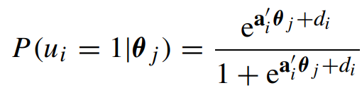
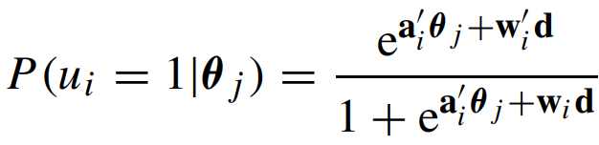
ONE DIMENSION IS RARELY ENOUGH
On many occasions, one than more ability is needed to explain the performance of a system.
θ becomes a vector and/or :
Multidimensional IRT models consider several dimensions for the abilities and/or the items
Reckase, M. D. (2006). 18 Multidimensional Item Response Theory. Handbook of statistics, 26, 607-642.
Bonifay, Wes. Multidimensional item response theory. Sage Publications, 2019.

Slide 9
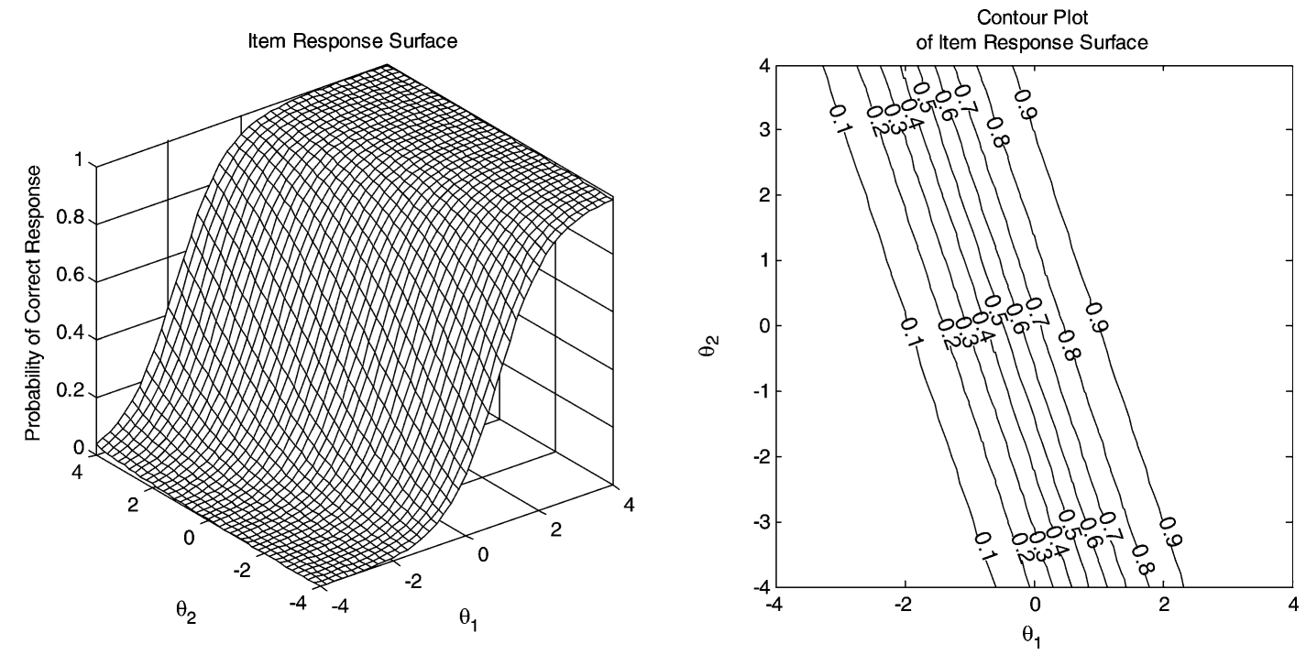
ITEM RESPONSE SURFACES : compensatory
Reckase, M. D. (2006). 18 Multidimensional Item Response Theory. Handbook of statistics, 26, 607-642.

Slide 10
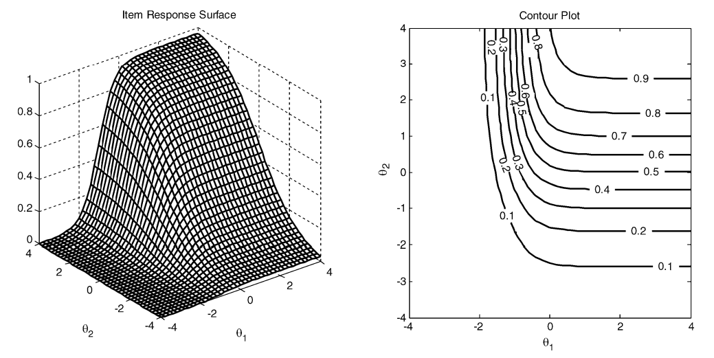
ITEM RESPONSE SURFACES : partially compensatory
Reckase, M. D. (2006). 18 Multidimensional Item Response Theory. Handbook of statistics, 26, 607-642.

Slide 11
When Difficulty/Demands Are Given

Slide 12
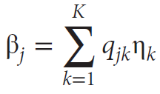
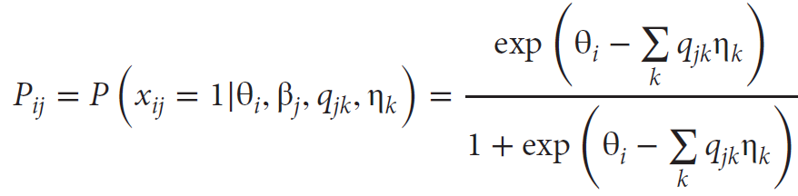
LineAR LOGISTIC TEST MODELS (lltm)
For each item j, assume item difficulty β_{j} depends linearly on a series of k cognitive components or item characteristics, also known as demands q_{jk}
Then, a Rasch (1PL) model simply becomes:
The q_{jk} are specified by experts, the parameters η_{k} are estimated.
Fischer, G. H. (2005). “Linear logistic test models,” In Encyclopedia of Social Measurement, 2, 505-514.

Slide 13
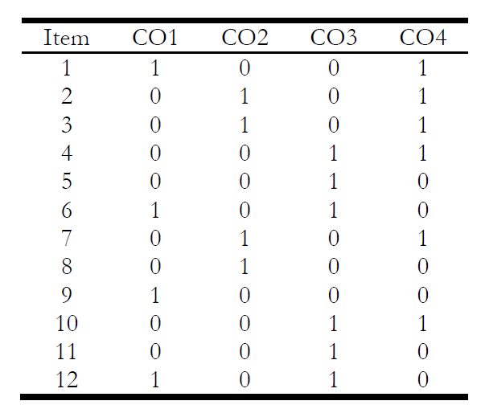
LineAR LOGISTIC TEST MODELS (lltm)
Domain experts think of how many features and how to label examples.
Q-matrix
Values can be > 1
LLTMs are compared with the Rasch model (it LLTM is significantly worse, then the cognitive demands are not good enough.
Packages: Baghaei, P., & Kubinger, K. D. (2015). Linear logistic test modeling with R. Practical Assessment, Research, and Evaluation, 20(1), 1.

Slide 14
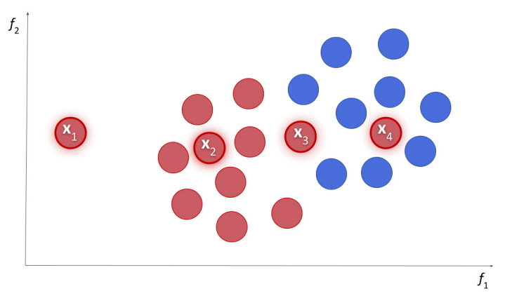
How to elicit DIFFICULTIES? EXTRINSIC
The difficulty of an instance depends on its relation to the other instances.
EXTRINSIC: A paradigmatic case is the concept of “instance hardness” in classification
But some of them do not depend on the models, just on the distribution of data.
X1: medium
X2: easy
X3: hard
X4: very hard.
Lorena, A. C., Paiva, P. Y., & Prudêncio, R. B. (2023). Trusting my predictions: on the value of Instance-Level analysis. ACM Computing Surveys.

Slide 15
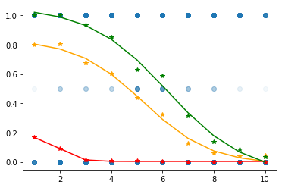
How to elicit DIFFICULTIES? INTRINSIC
In some cases, the difficulty of an instance is easy to identify and they are intrinsic.
INTRINSIC: The difficulty of an instance doesn’t depend on the difficulty of other instances!!!
Zhou et al. “Scaled-up, Shaped-up, but Letting Down? Reliability Fluctuations of Large Language Model Families” , in preparation, 2023.
GPT (3, 3.5, 4) on addition problems with difficulty being the mean of #digits

Slide 16
AUTOMATED demand Annotation in nlp
Syntantic and semantic complexity metrics (e.g., Quanteda)

Slide 17
LLM for demand annotation
Linguistic Meta-features (annotated by GPT-4):
Yael Moros-Daval “Automated Annotation of Meta-Features for Predicting Language Model Performance in Natural Language Processing Tasks”, 2023

Slide 18
Could we use lltm?
Tasks (thousands of items) and models (dozens of subjects) from HELM (summer 2023)
Liang, P., Bommasani, R., Lee, T., Tsipras, D., Soylu, D., Yasunaga, M., ... & Koreeda, Y. (2022). Holistic evaluation of language models. arXiv preprint arXiv:2211.09110.

Slide 19
Yes, but we didn’t (used xg-boost)
Each dot is an instance of MMLU US FP, with average error for all models on the x axis and the predicted average error on the y axis.

Slide 20
General Difficulty Models

Slide 21
Data for difficulty
Once we have applied IRT or used any other method to estimate the difficulties of the instances, we end up with a dataset like this:
Item | Original Features | Difficulty | Discrim.
#1 | What’s the capital of France? | -2.5 | 0.6
#2 | What’s almost an island? | 0.3 | 0.7
#3 | What’s the capital of Bhutan? | 0.7 | 0.2
#4 | What’s frozen water? | -1.8 | 0.3
#5 | Who’s your mother’s son’s mother? | -0.5 | 0.2
#6 | What’s brown and sticky? | 2.3 | -0.3
... | ... | ... | ...
Can we predict difficulty (and discrimination) from the features?

Slide 22
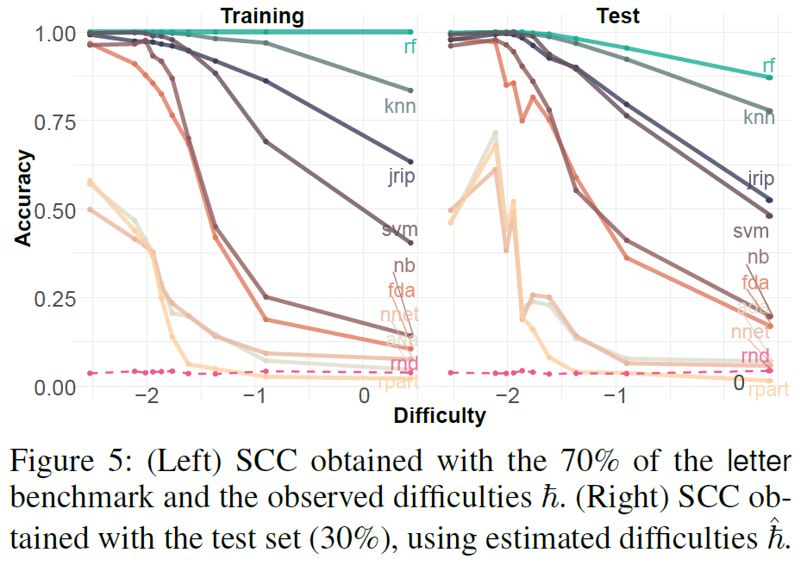
Yes, we can
But we can build a difficulty model from the instance features:
Better with 1PL models:
Martínez-Plumed, F., Castellano, D., Monserrat-Aranda, C., & Hernández-Orallo, J. (2022, June). When ai difficulty is easy: The explanatory power of predicting IRT difficulty. In Proceedings of the AAAI Conference on Artificial Intelligence (Vol. 36, No. 7, pp. 7719-7727).

Slide 23
Predicting Performance Directly:
Assessors
JH Orallo, W Schellaert, FM Plumed
Training on the Test Set: Mapping the System-Problem Space in AI
AAAI 2022

Slide 24
definition
Conditional probability estimator of the result r for AI system π on situation μ:
It is trained (and evaluated) on test data:
Using a distribution of situations (instances) μ.
Using a distribution of systems π.
π | μ | r
Resnet, θ₁, θ₂, … | Image3, χ₁, χ₂, … | 1
Resnet, θ₁, θ₂, … | Image23, χ₁, χ₂, … | 0
… | … | ...
Inception, θ₁, θ₂, … | Image3, χ₁, χ₂, … | 1
Inception, θ₁, θ₂, … | Image78, χ₁, χ₂, … | 1
… | … | ...
It is applied during deployment, before π does any inference or even starts.

Slide 25
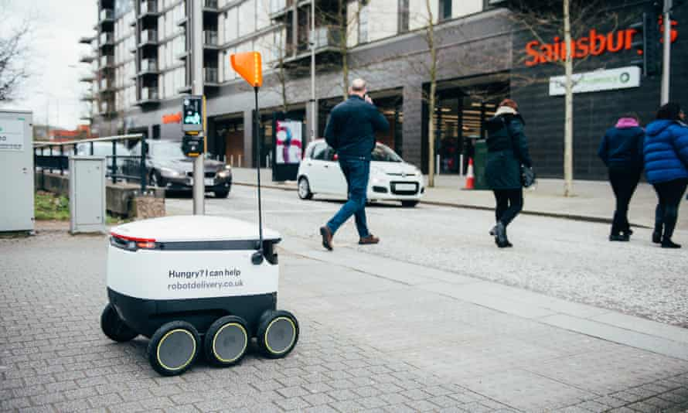
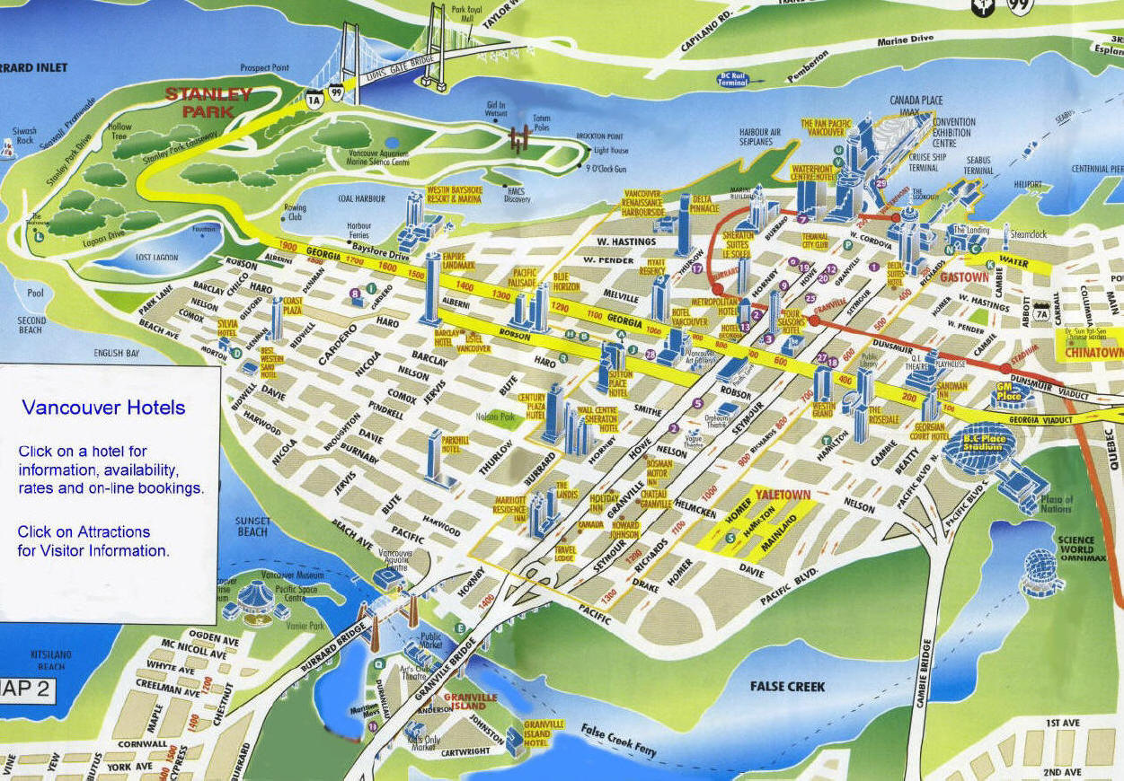
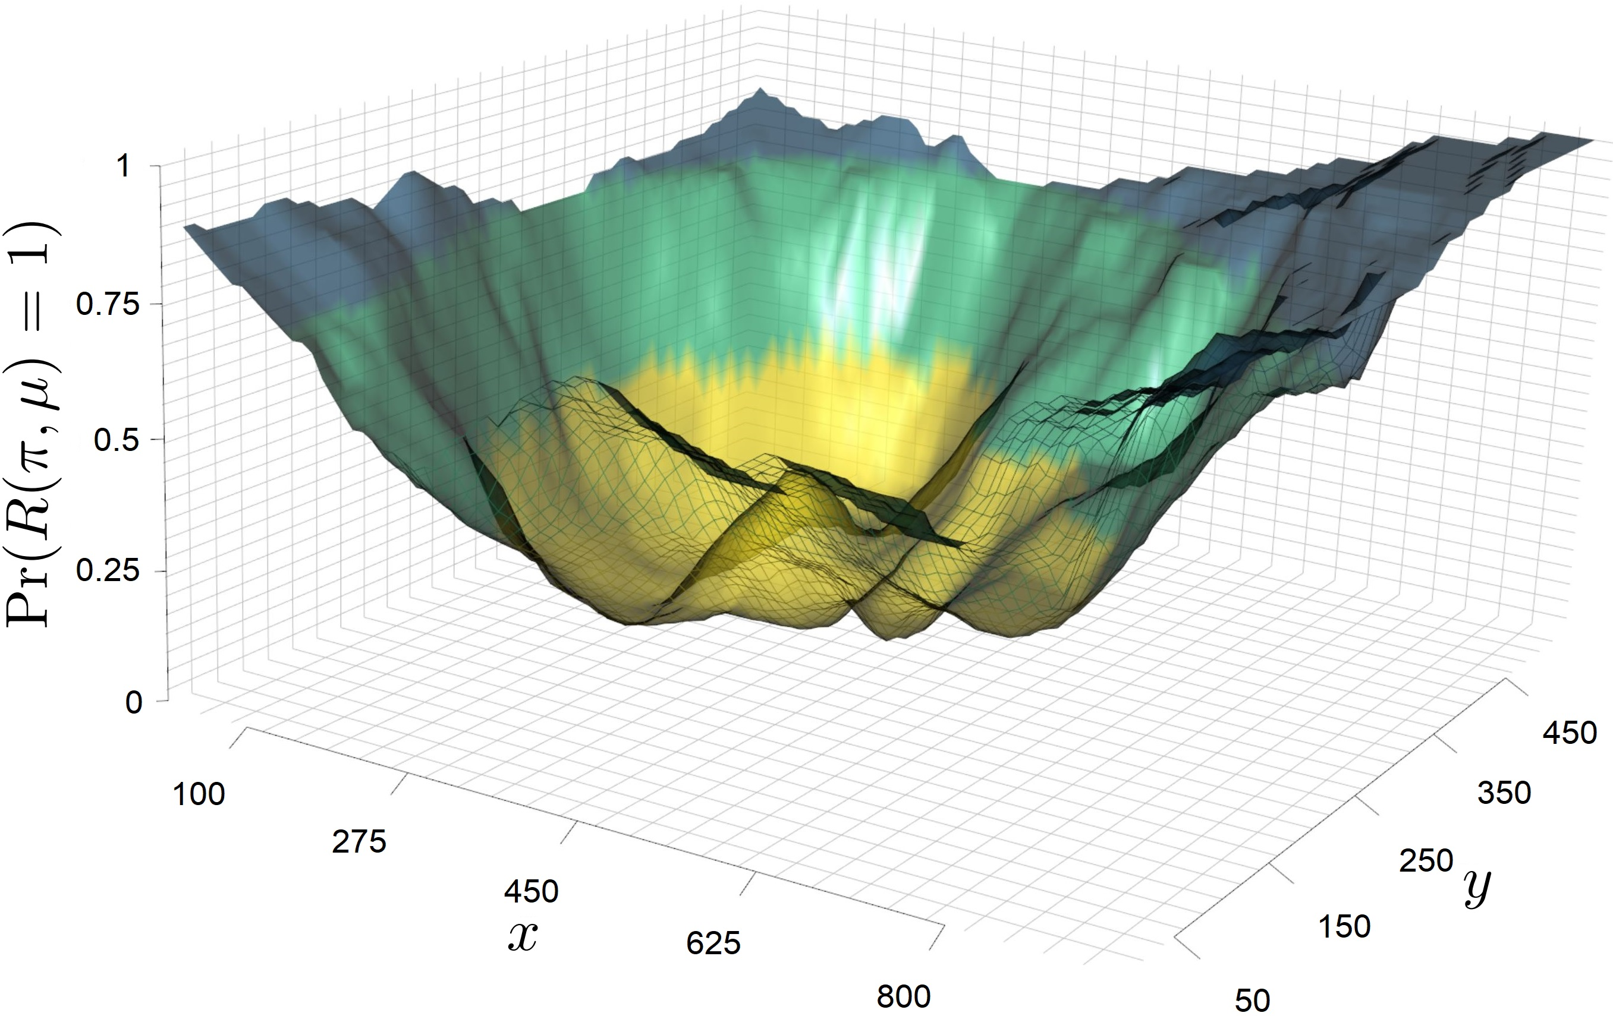
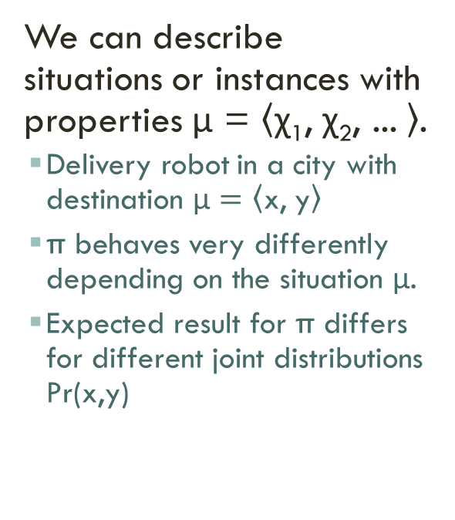
PROBLEM SPACE
Downtown Vancouver
We can describe situations or instances with properties μ = $\left\langle \text{χ}\text{1}\text{,} \text{χ}\text{2}\text{,}\text{ ...} \right\rangle$.
Delivery robot in a city with destination μ $=\left\langle \text{x}\text{,} \text{y}\right\rangle$
π behaves very differently depending on the situation μ.
Expected result for π differs for different joint distributions Pr(x,y)

Slide 26
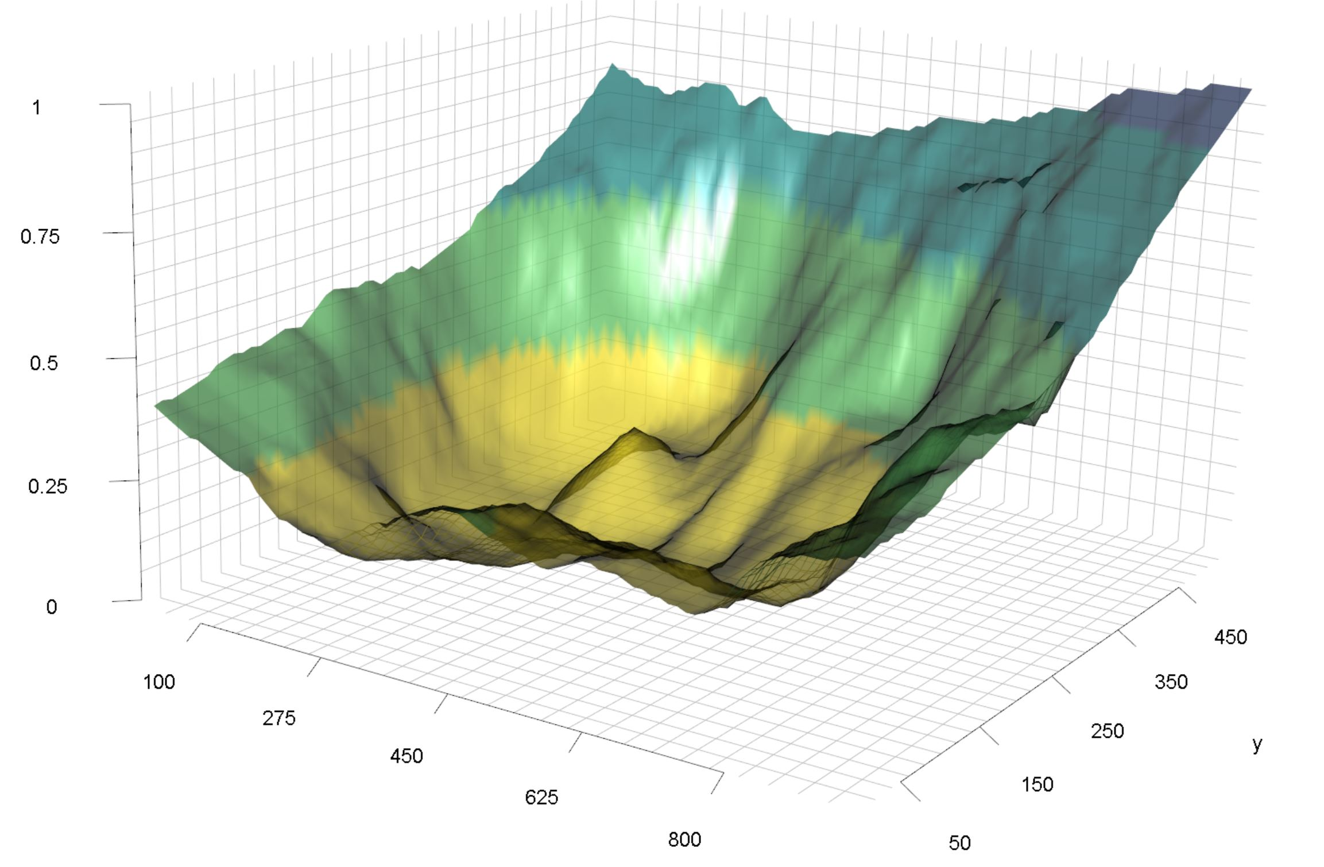
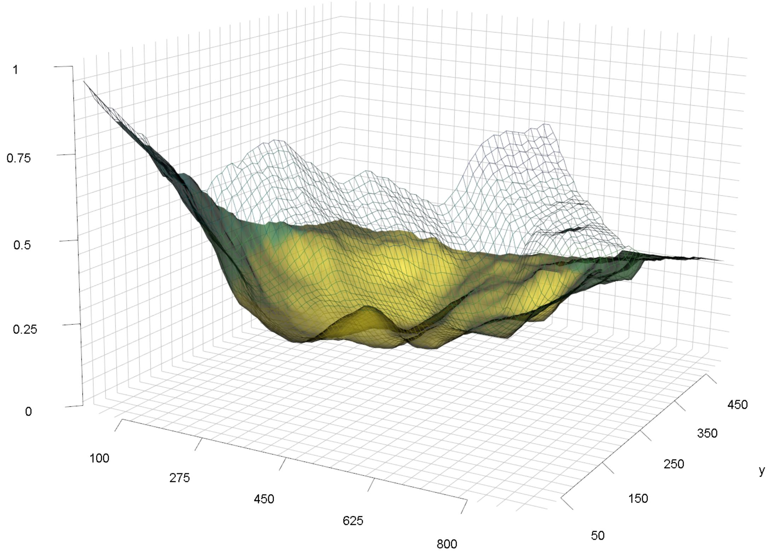
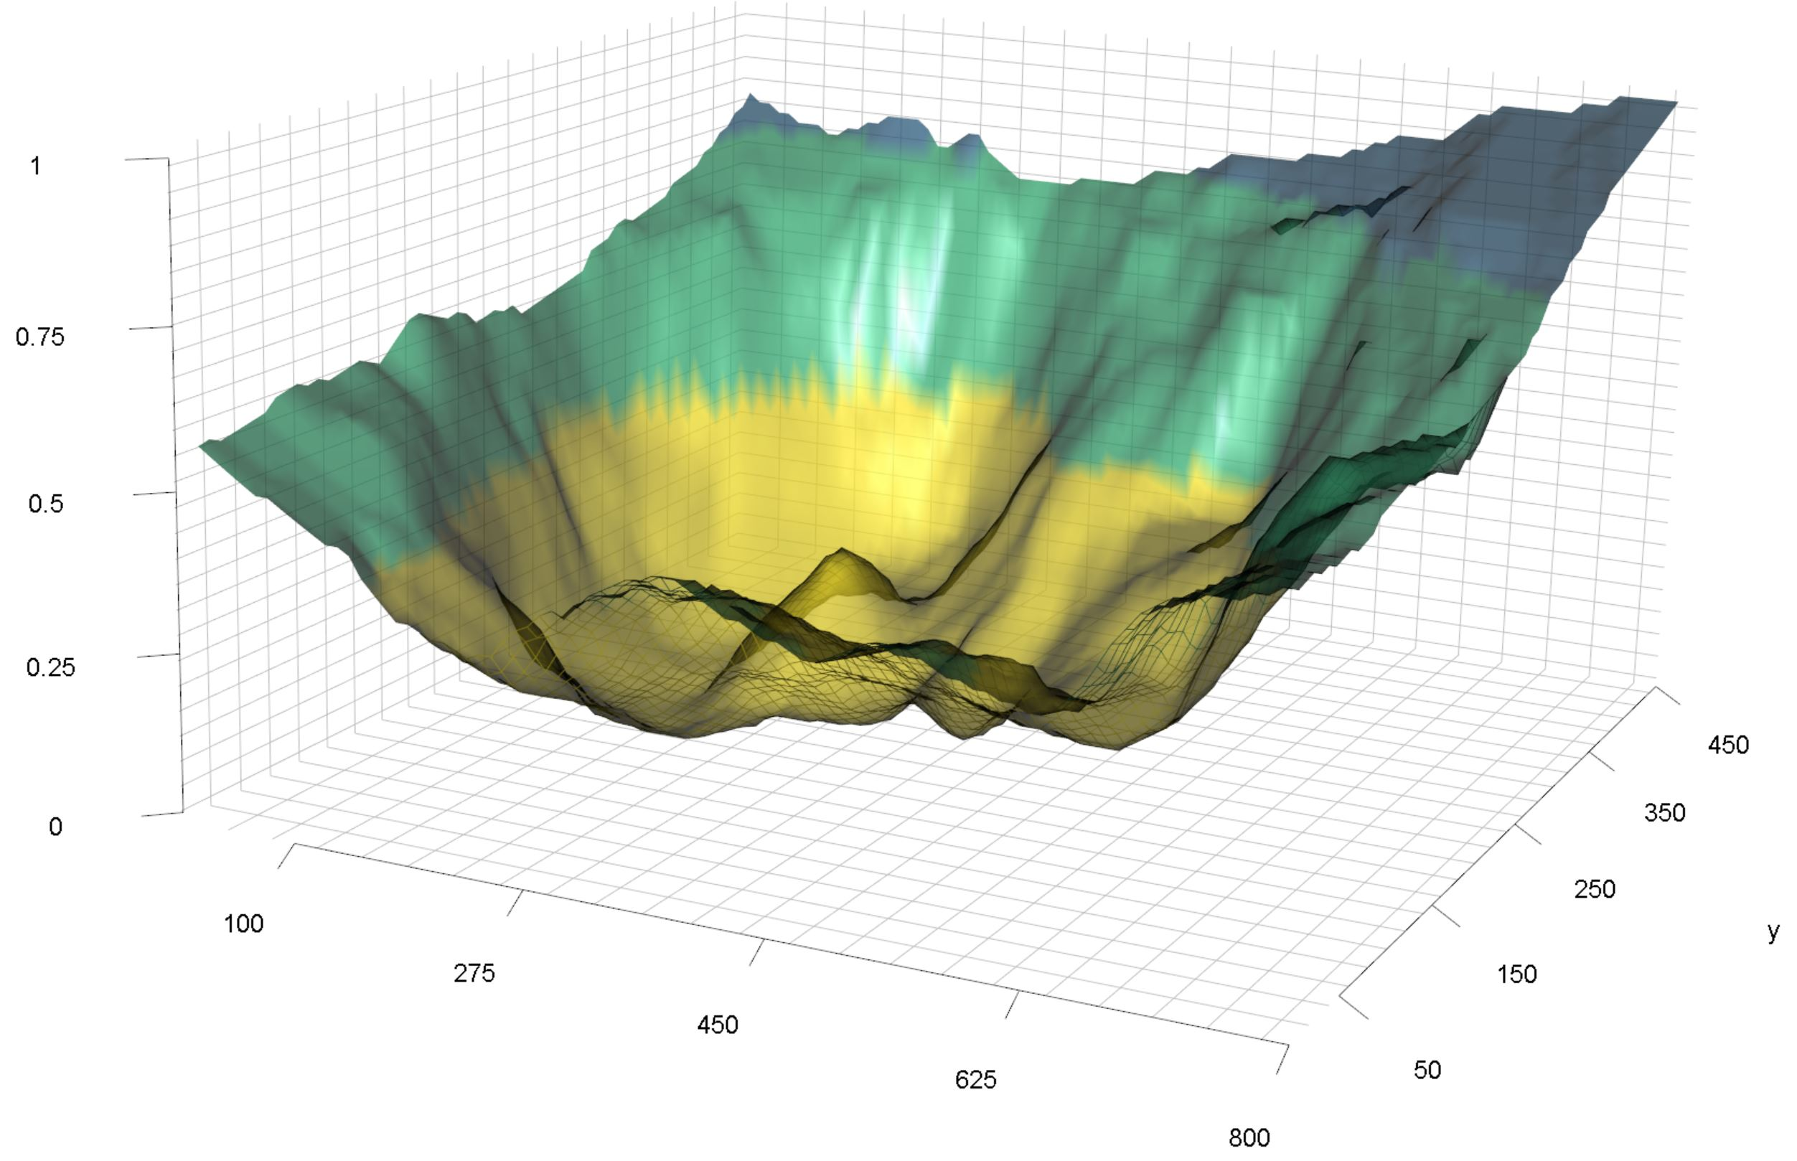
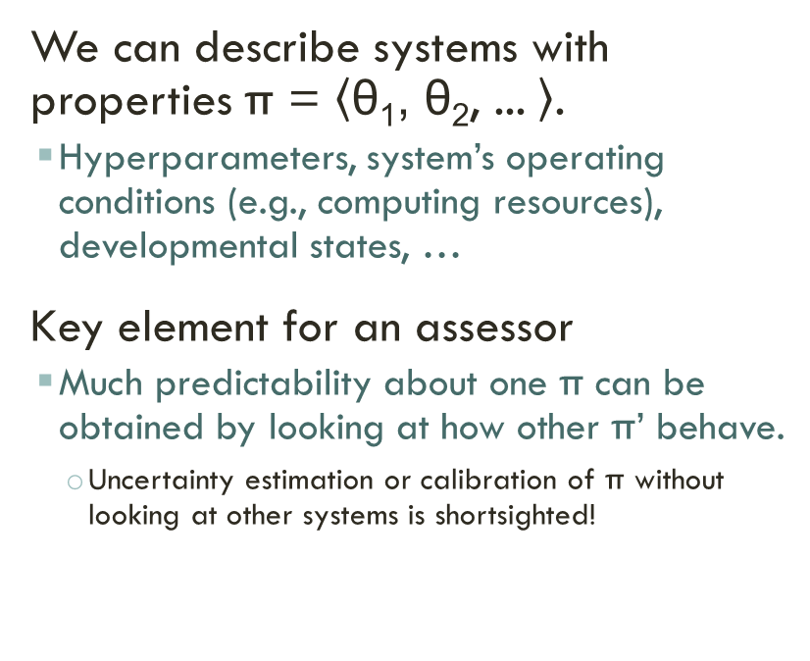
System space
Pr(R(π₃, · )=1)
Pr(R(π₁, · )=1)
Pr(R(π₂, · )=1)
. . . .
. .
. . . .
. .
. . . . .
.
. .
. . .
.
. . .
. . .
. .
. . . .
.
. . . . .
.
. .
. . .
.
. . .
. . . .
. .
. . . .
. .
. . . . .
.
. .
. . .
.
. . .
We can describe systems with properties π = $\left\langle \text{θ}\text{1}\text{,} \text{θ}\text{2}\text{, ...} \right\rangle$.
Hyperparameters, system’s operating conditions (e.g., computing resources), developmental states, …
Key element for an assessor
Much predictability about one π can be obtained by looking at how other π’ behave.
Uncertainty estimation or calibration of π without looking at other systems is shortsighted!
. . . .
. .
. . . .
. .
. . . . .
.
. .
. . .
.
. . .
. . . .
. .
. . . .
. .
. . . . .
.
. .
. . .
.
. . .
points are “coloured” by the system attributes
. . . .
. .
. . . .
. .
. . . . .
.
. .
. . .
.
. . .
^
R(r | π₁,μ)

Slide 27
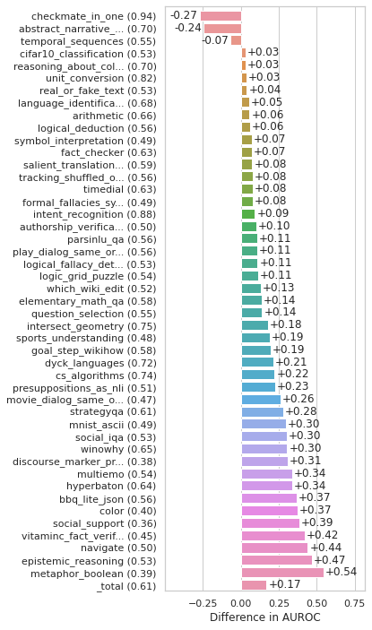
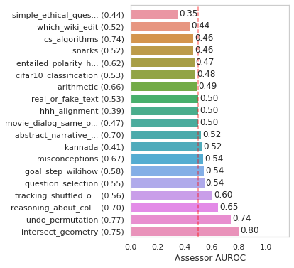
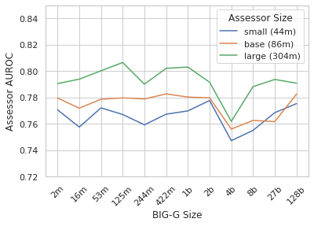
LMs predict LMs
(baseline): self-assessment
(baseline: self-assessment)
asssessor
Setup:
Problem space (items):
BIG-bench evaluation suite (millions of instances)
System space (subjects):
Validity (correct/incorrect) for 12 LMs (200M to 128B parameters)
Assessor:
Small-ish assessor (60M DeBERTa)
asssessor
OOD: Not significantly better than self-assessment (logprobs)
In distribution:
Total AUROC of 0.61
Improvement over self-assessment (logprobs)
Bigger assessor = better
Bigger subject = neutral
Schellaert et al. “Validity Predictability Factors in Language Models” (forthcoming)

Slide 28
Extracting Task Demands Cognitively
R Burnell, J Burden, D Rutar, K Voudouris, L Cheke, J Hernández-Orallo
“Not a Number: Identifying Instance Features for Capability-Oriented Evaluation”
IJCAI 2022

Slide 29
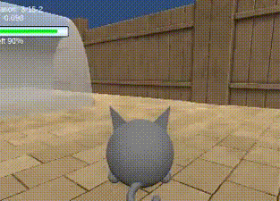
How can we identify capabilities?
Selected subset of AAIO instances measuring simple goal-directed behaviour
Data across 99 instances from 68 agents
M Crosby, B Beyret, M Shanahan, J Hernández-Orallo, L Cheke, M Halina “The animal-AI testbed and competition” NeurIPS 2019 Competition and Demonstration Track, Proceedings of Machine Learning Research, 2020
http://lcfi.ac.uk/projects/kinds-of-intelligence/animalaiolympics/

Slide 30
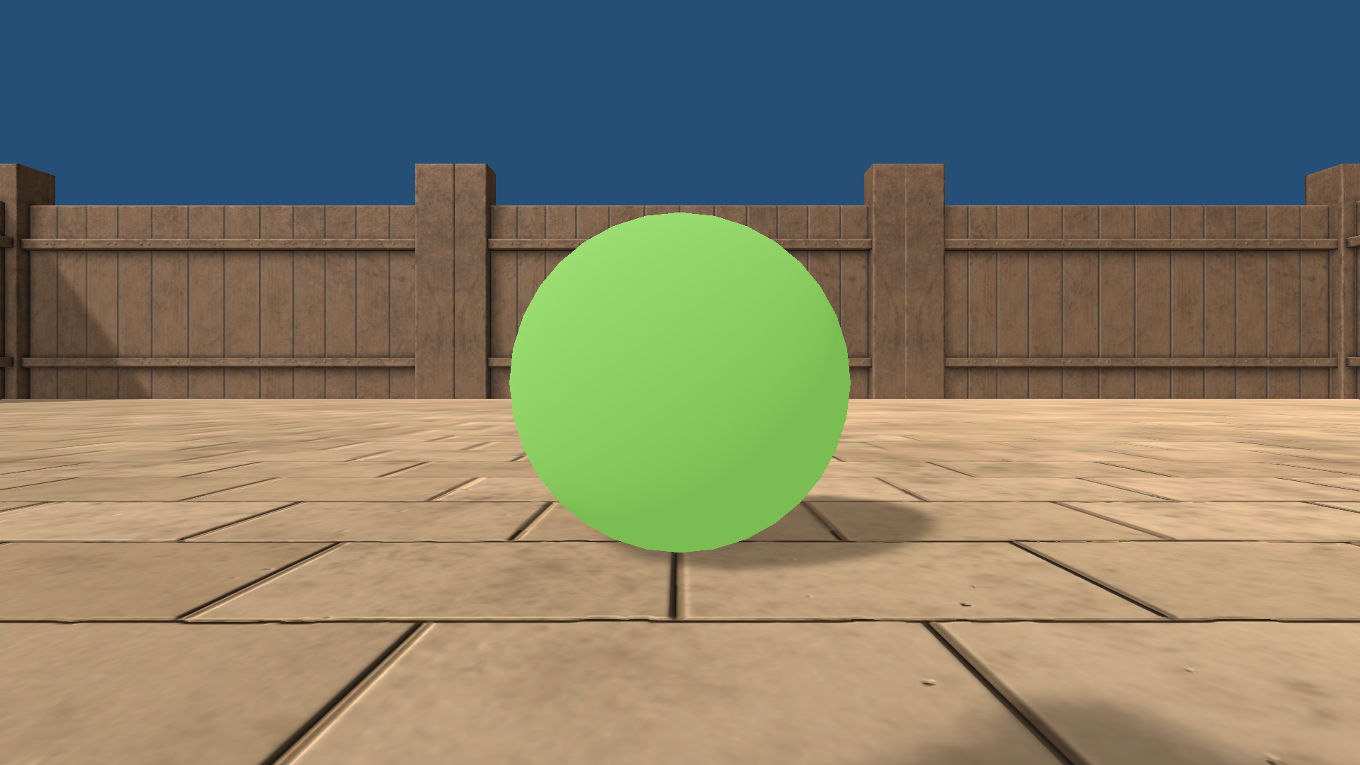

Identifying features of interest
Relevant
Reward size
Reward distance
Reward in view (i.e., in front vs behind)
Irrelevant
Reward side (left vs right)
Reward colour (green vs yellow)

Slide 31
dimensions and agent characteristic curves

Slide 32
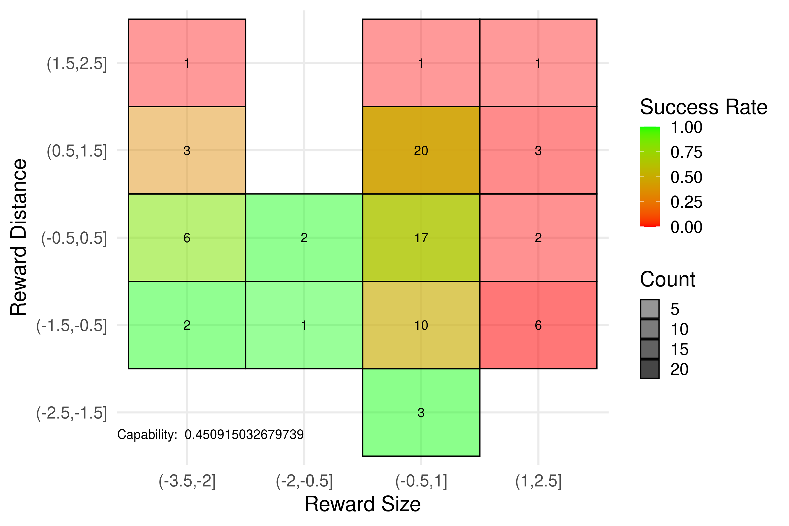
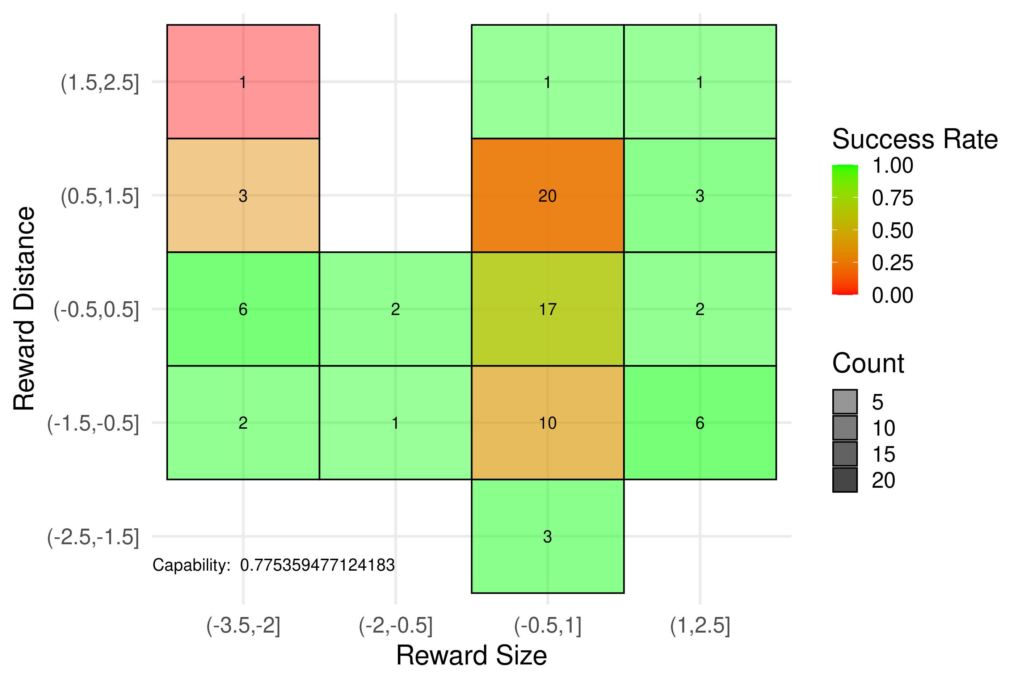
Capabilities vs no-capabilities
Capability boundary
This system doesn’t show monotonicity.
We can’t identify any level of capability robustly.
Reward Size (large to small)
Reward Size (large to small)
Conformant System
Non-Conformant System
Juohmaru
y.yang

Slide 33
Predicting performance POSSIBLE
avg
G.Acc. : extrapolate Global ACCuracy
? = 54.7%
(ignores system locality and feature relevance)
T.Acc. extrapolate agenT ACCuracy
? = 46.8%
(ignores feature relevance)
avg
?
avg
B.Acc. : extrapolate Bin ACCuracy
? = 40%
(ignores other bins)
Reward Size (large to small)
logistic
Par. : use parametric model on capabilities
? = 73.2%
(parameter goodness-of-fit may be poor)
Reward Size (large to small)
Except the last one, these are basically non-inferential methods (constant models or binning extrapolations)

Slide 34
Predicting performance NOT POSSIBLE?
ML model
A : use assessor models
(Using all variables or only the relevant ones?)
?
Reward Size (large to small)
Reward Size (large to small)
assessors = let’s use all the power of ML to characterise the system’s performance!!

Slide 35
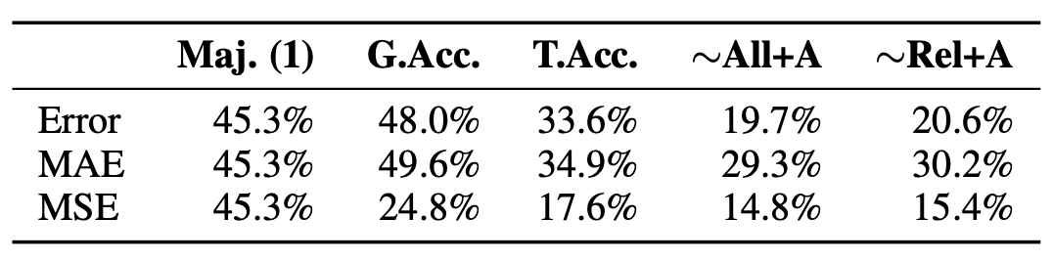
Predicting performance (comparison)
Animal AI Competition Data: 99 instances x 68 agents

Slide 36
Measurement Layouts
J. Burden et al. “Inferring Capabilities from Task Performance with Bayesian Triangulation”, https://arxiv.org/abs/2309.11975.

Slide 37

MEASUREMENT LAYOUTS : simple example (aaio)
To be replaced by measurement layouts with Language models
The x-axis and y-axis show the inferred means for navigationAbility and visualAbility respectively, with their standard deviations as error bars in grey. The radius of each point represents the average performance, while the colour represents the noiseLevel (red higher than blue).
J. Burden et al. “Inferring Capabilities from Task Performance with Bayesian Triangulation”, https://arxiv.org/abs/2309.11975.

Slide 38
MEASUREMENT LAYOUTS : more complex (o-piaagets)
To be replaced by measurement layouts with Language models

Slide 39
MEASUREMENT LAYOUTS : more complex (o-piaagets)
To be replaced by measurement layouts with Language models
Very similar performance, very different cognitive profiles

Slide 40
MEASUREMENT LAYOUTS : predictability
To be replaced by measurement layouts with Language models

Slide 41
Other Modelling Approaches

Slide 42
OTHER METHODS
Minka, T., Cleven, R., & Zaykov, Y. (2018). Trueskill 2: An improved bayesian skill rating system. Technical Report.
From Games and AI:
Elo-Ranking, TrueSkill???
From Psychometrics:
Hierarchical models (HGLMs, Multi-level IRT).
Factor analysis (next slide)
To be done. One slide?
Ravand, H. (2015). Item response theory using hierarchical generalized linear models. Practical Assessment, Research, and Evaluation, 20(1), 7.
Sulis, I., & Toland, M. D. (2017). Introduction to Multilevel Item Response Theory Analysis: Descriptive and Explanatory Models. The Journal of Early Adolescence, 37(1), 85-128. https://doi.org/10.1177/0272431616642328

Slide 43
?
FACTOR ANALYSIS
Burnell, R., Hao, H., Conway, A. R., & Orallo, J. H. (2023). Revealing the structure of language model capabilities. arXiv preprint arXiv:2306.10062.

Slide 44
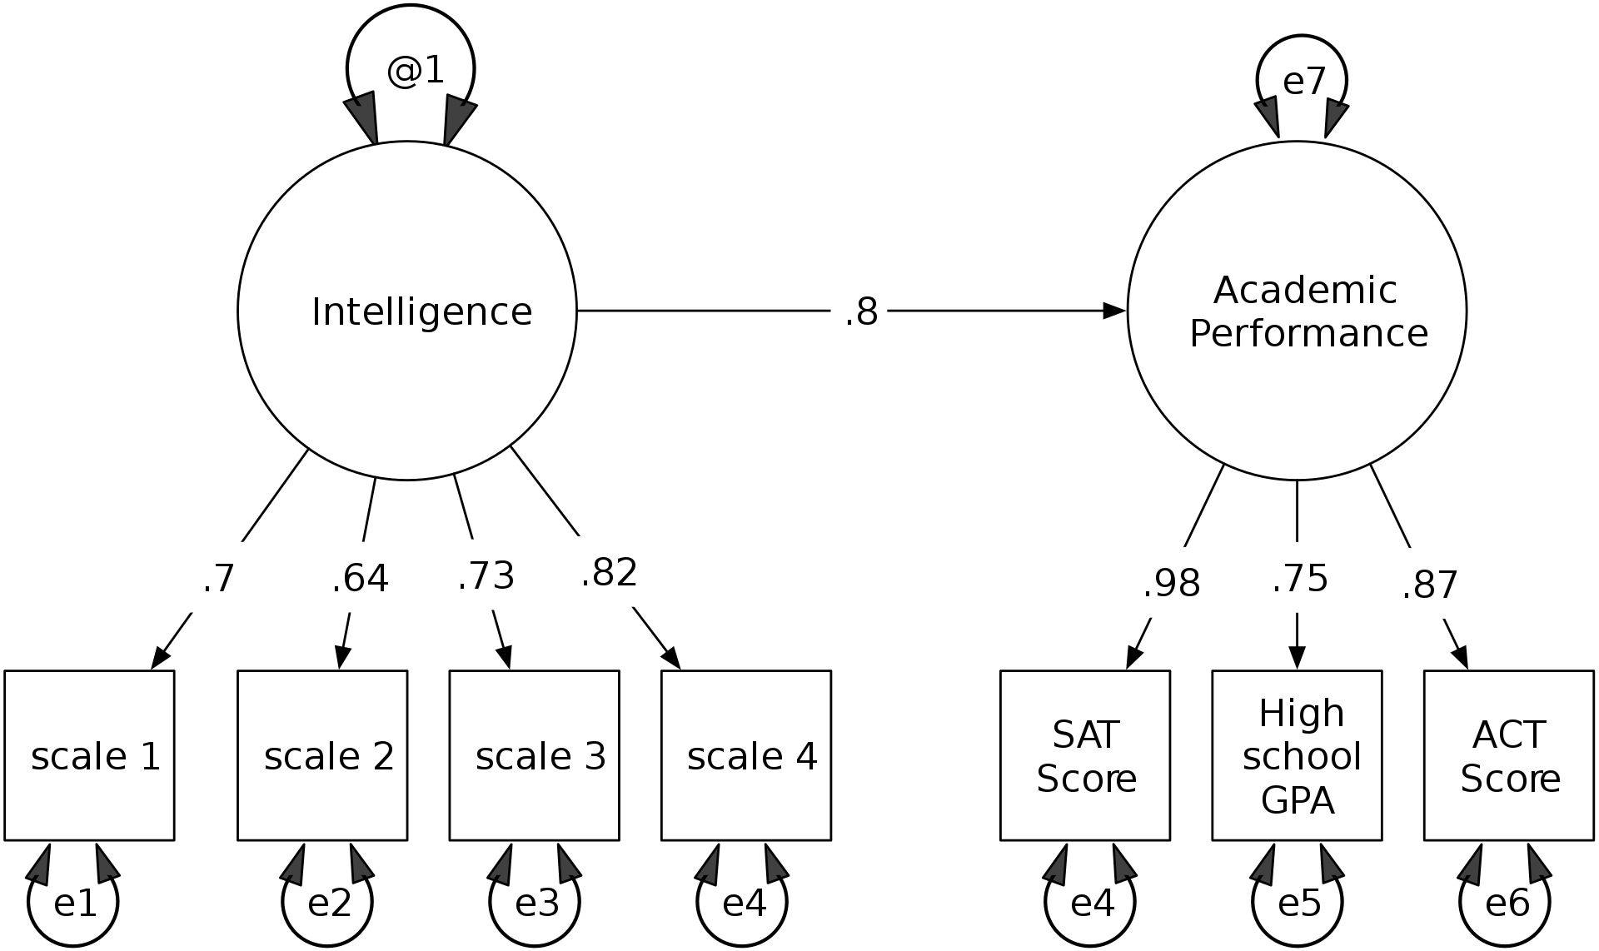
Populational? Instance-level?
Structural Equation Modelling
Needs a sample of subjects
Bottom-up inference at the level of tests
Inference of values
Arrows represent linear relations
Measurement Layouts (Bayesian inference)
Estimate capabilities from the results of one individual
Bottom-up and top-down inference at instance level.
Inference of distributions
Arrows may be any differential function (e.g., logistic)
Question: Are SEMs or other models for just one individual?

Slide 45
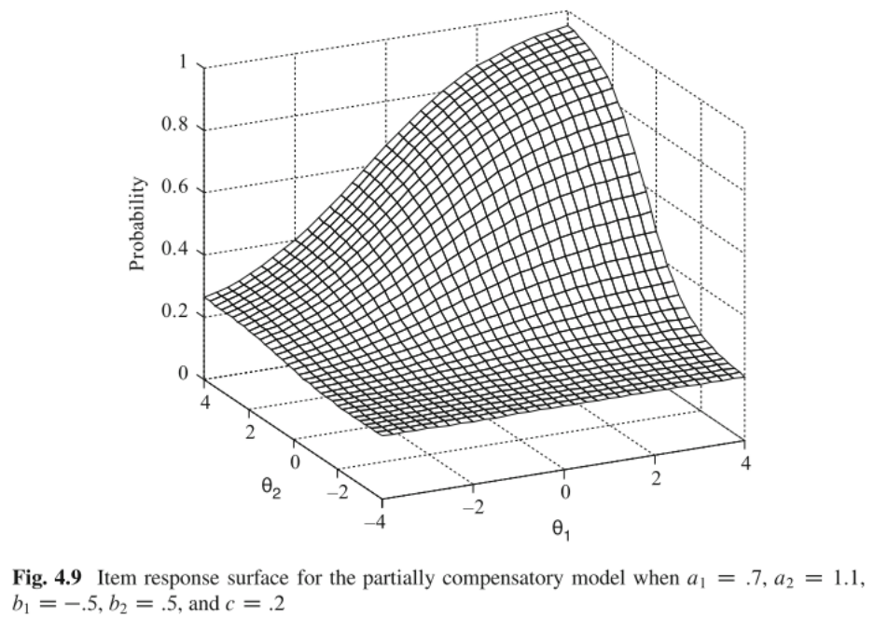
MULTIDIMENSIONAL IRT GENERALISED?
MIRT – Compensatory abilities
Needs a sample of subjects
Latent/population difficulties (no given features)
Fixed model (logistic / beta)
Measurement Layouts
Estimate capabilities from the results of one individual
Looks at the instance features (observable demands)
Arrows only need be differentiable (beyond logistic)
“Multidimensional Item Response Theory” (V. Duran’s slides)
Question: Degree of compensation for many dimensions and hierarchies?

Slide 46
Summary OF approaches
Approach | Item | Predictive | Domain Knwldge. | Populational | Abilities | Type of Models | Hierarchical
Traditional IRT (1PL, 2PL, 3PL) | Yes | Seen items | No | Yes | 1 | Logistic/Bernouilli (response) | No
Beta/Gamma IRT Models, ... | Yes | Seen items | No | Yes | 1 | Beta (response), Gamma (response), ... | No
Multidimensional IRT | Yes | Seen items | Partly | Yes | ≥1 | Logistic (response) | No
LLTM | Yes | Yes | Yes | Yes | 1 (≥1MIRT) | Linear (diff) + Logistic (response) | Demands Only
Factor Analysis | No | No | No | Yes | ≥1 | Linear (response) | No
SEM | No | Yes* | Yes | Yes | ≥1 | Mostly Linear (response) | Yes
General Difficulty Model | Yes | Yes | No | Yes | ≥1 | Any machine learning model (diff) + Logistic | No
Intrinsic Difficulty | Yes | Yes | Yes | No | ≥1 | No model + Logistic | No
Assessors | Yes | Yes | No | Yes* | — | Any Machine Learning Model | No
Measurement Layouts | Yes | Yes | Yes | No* | ≥1 | Any Bayesian Model if Differentiable | Yes
Yes in this column means that we can predict performance for a new item, not used in the estimations.

Slide 47
IRT and other models predicting performance : the road ahead

Slide 48
challenges
To be done...

Slide 49
NEEDS
Instance-level data:
For building good predictive models of AI validity, we need evaluation results at the instance level.
Is sharing code open source (github) enough?
Re-running the experiments is not feasible/sustainable anymore.

Slide 50
TAKE-AWAYS
To be done...
Where to include other software & libràries for all these things (beyond py-irt), e.g., flexMIRT, MIRT, Stan, JAGS, Mplus, SPSS

Slide 51
THANK YOU!
JOSE H. ORALLO
http://josephorallo.webs.upv.es/
jorallo@upv.es

